Slide 1
WEBSITE-PROJECTS THUAN MAI

Slide 2
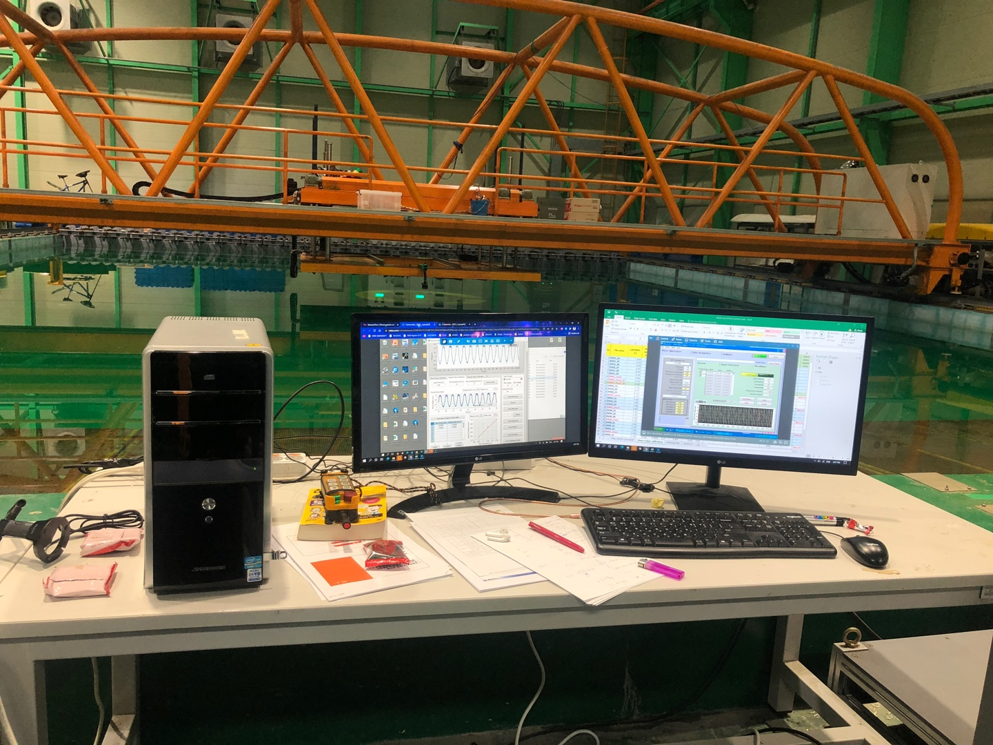
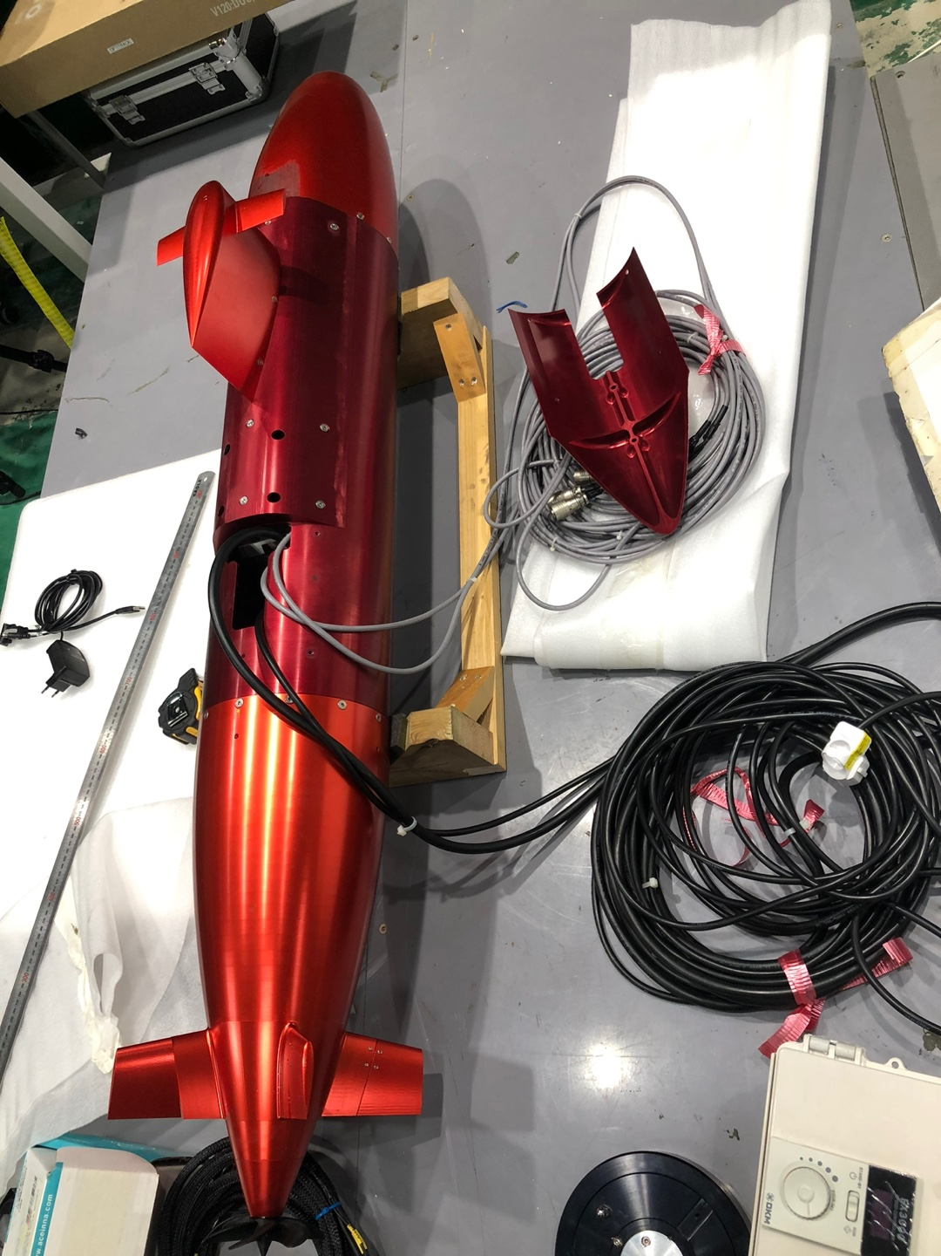
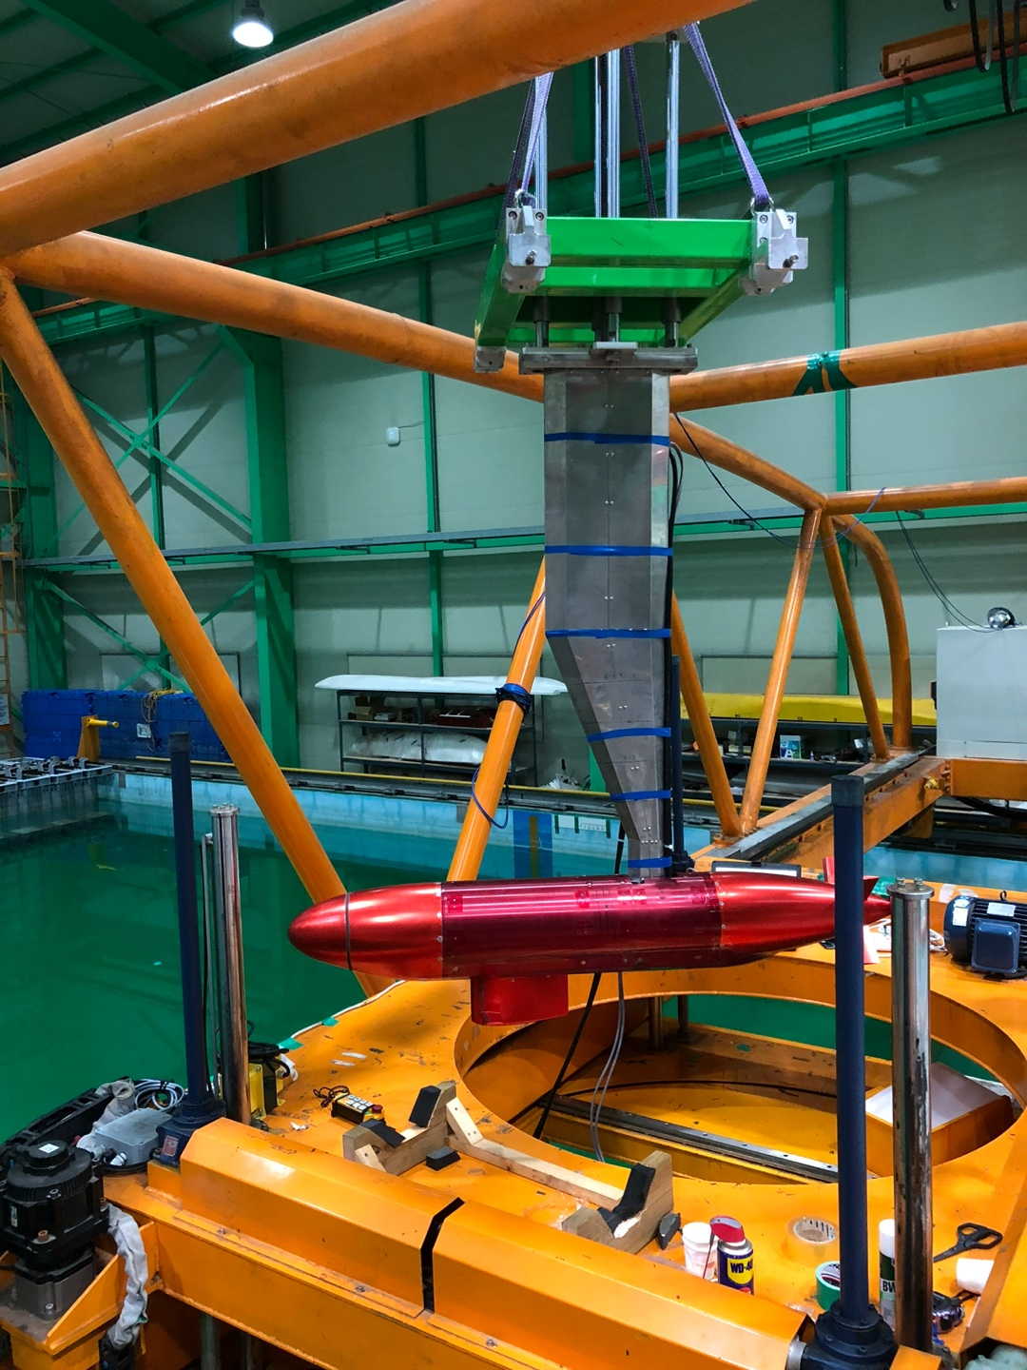
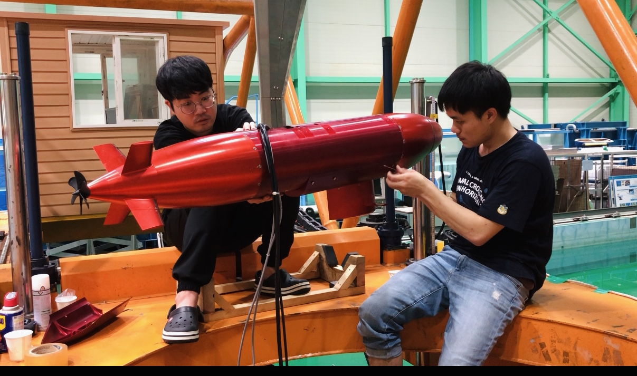
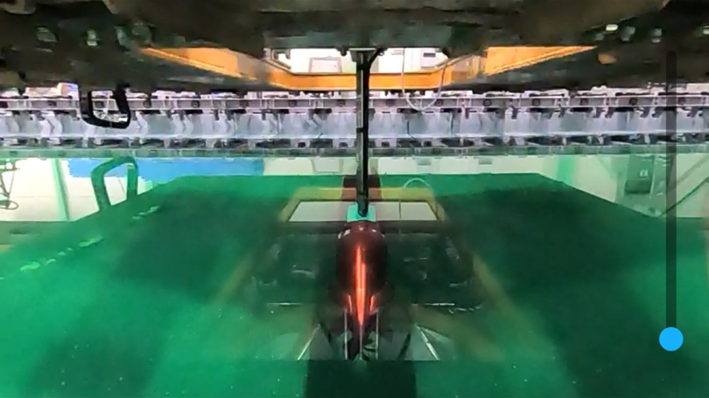
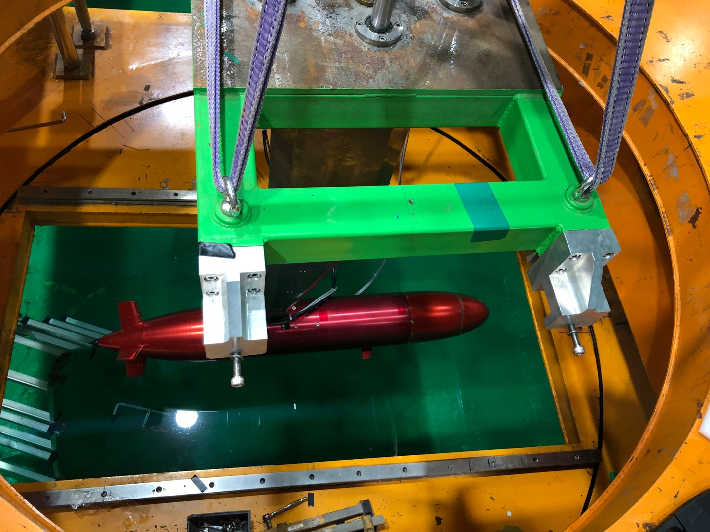
BB2
BB2 Submarine
Carriage position
Main computer
BB2 model
Pre-test
Model test

Slide 3
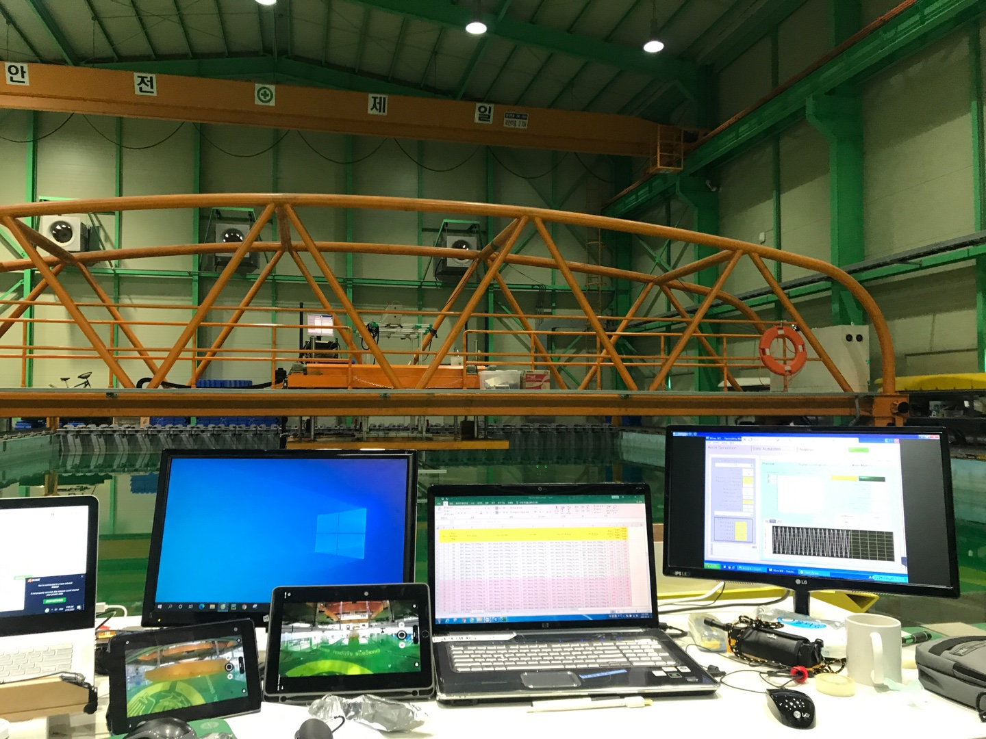
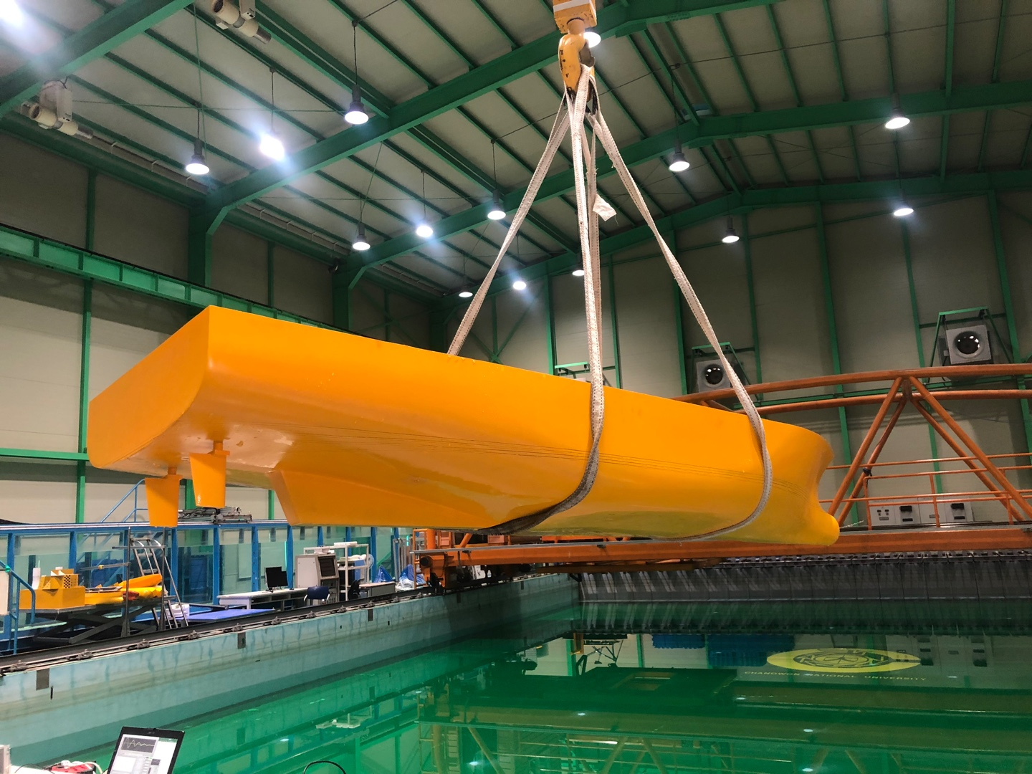
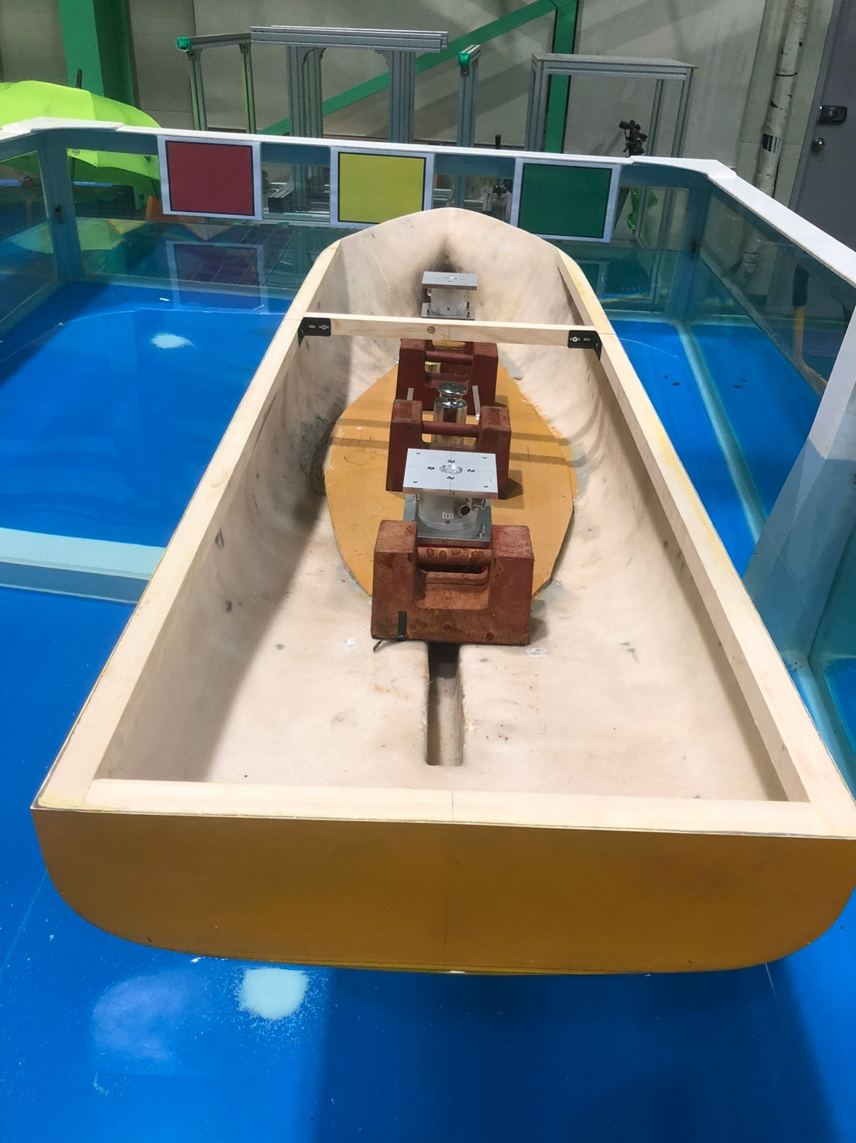
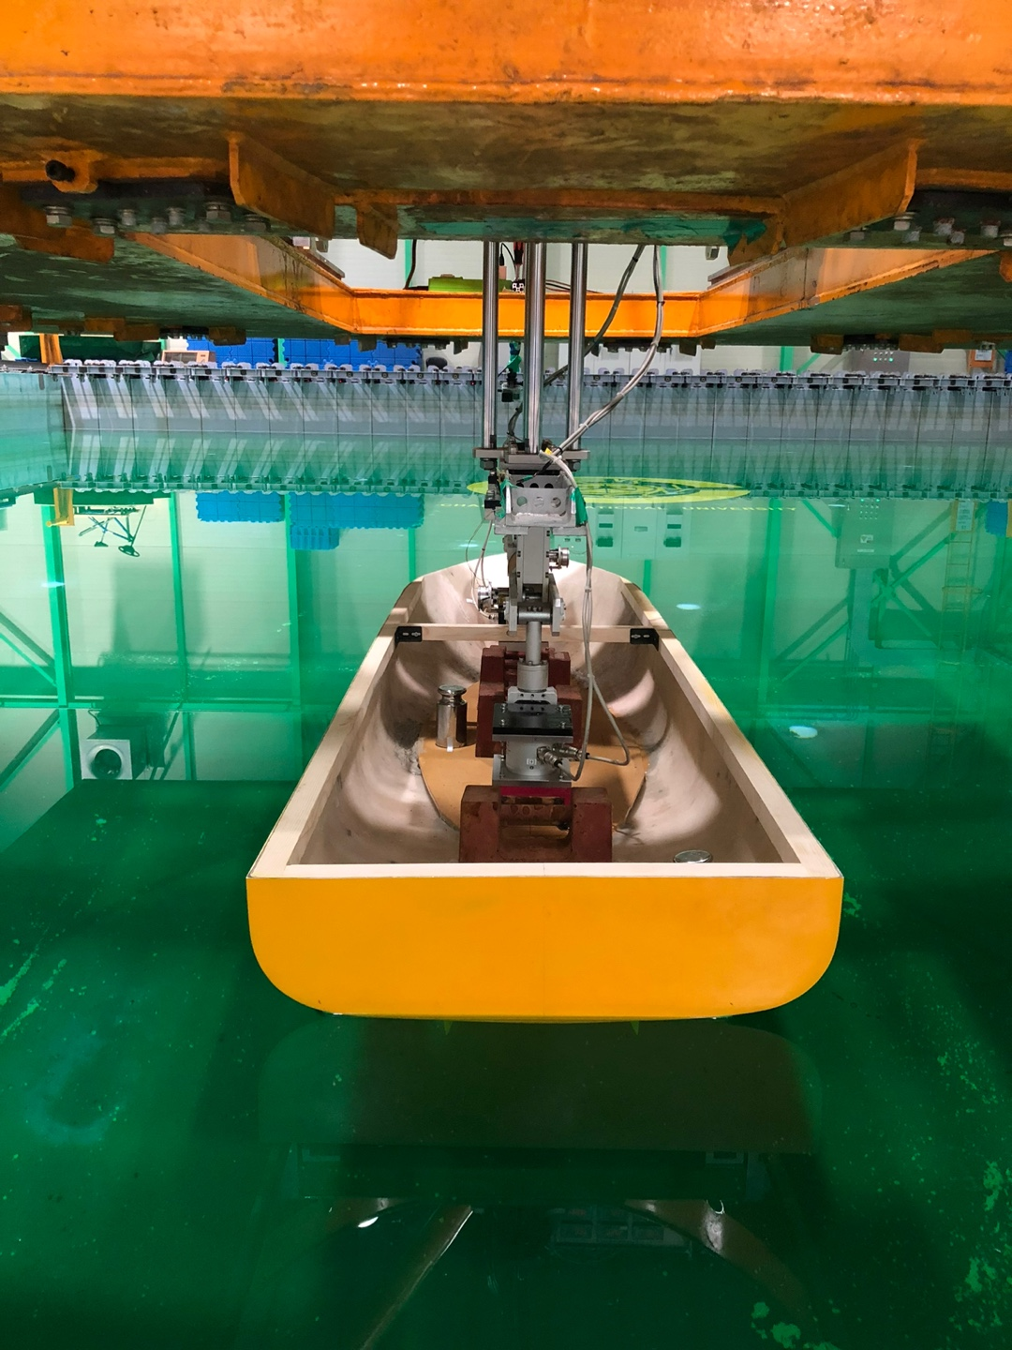
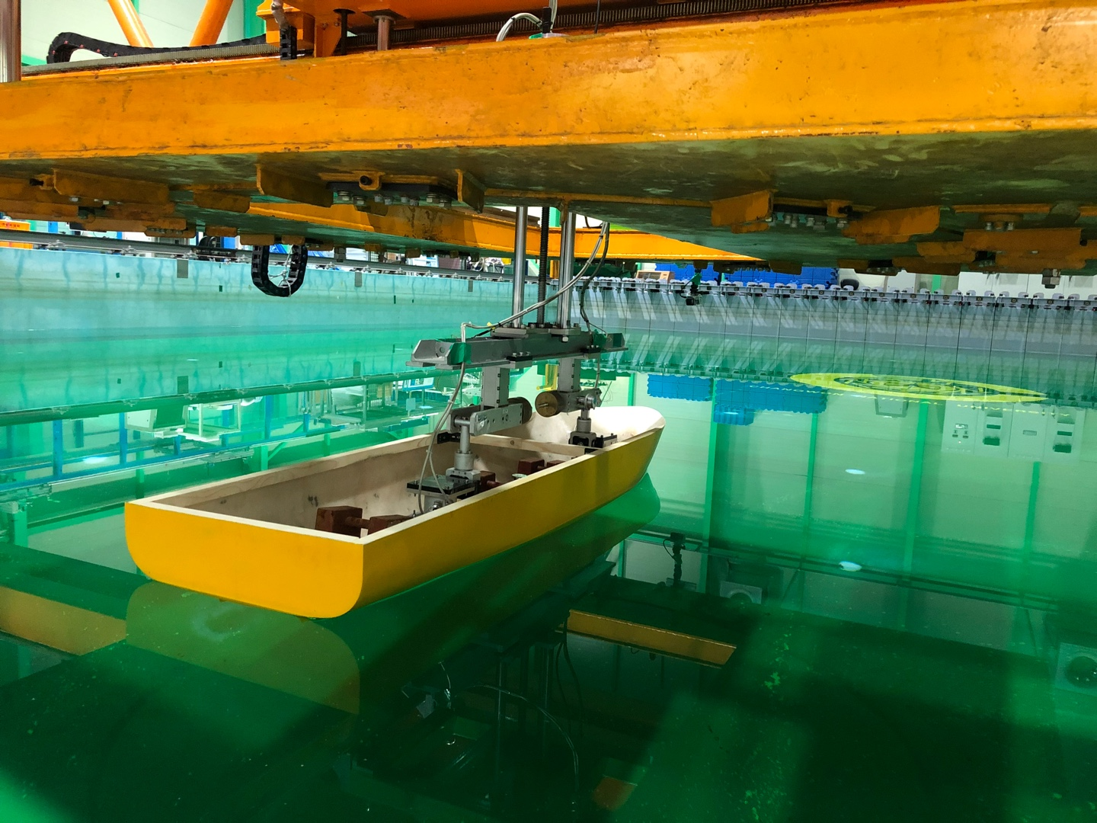
KASS
KASS
Main computer
Ballasting test

Slide 4
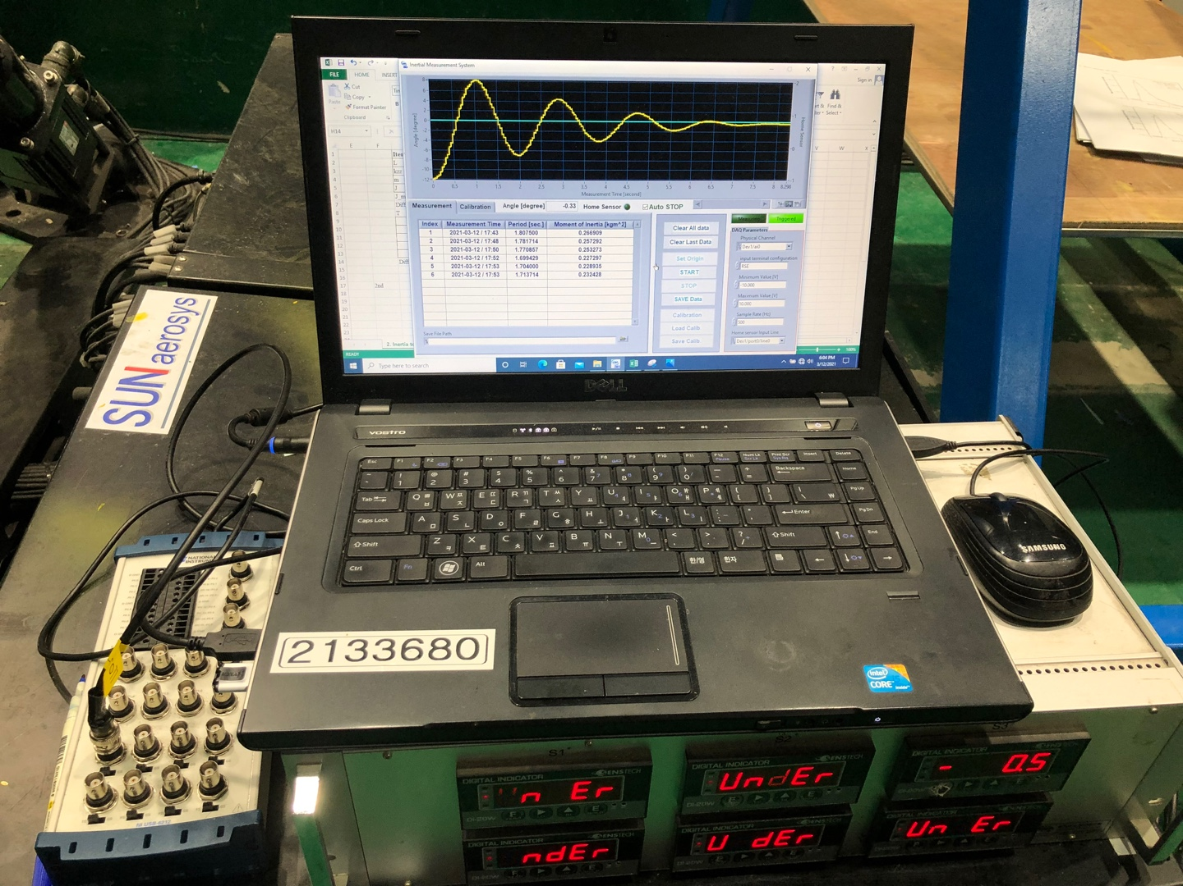
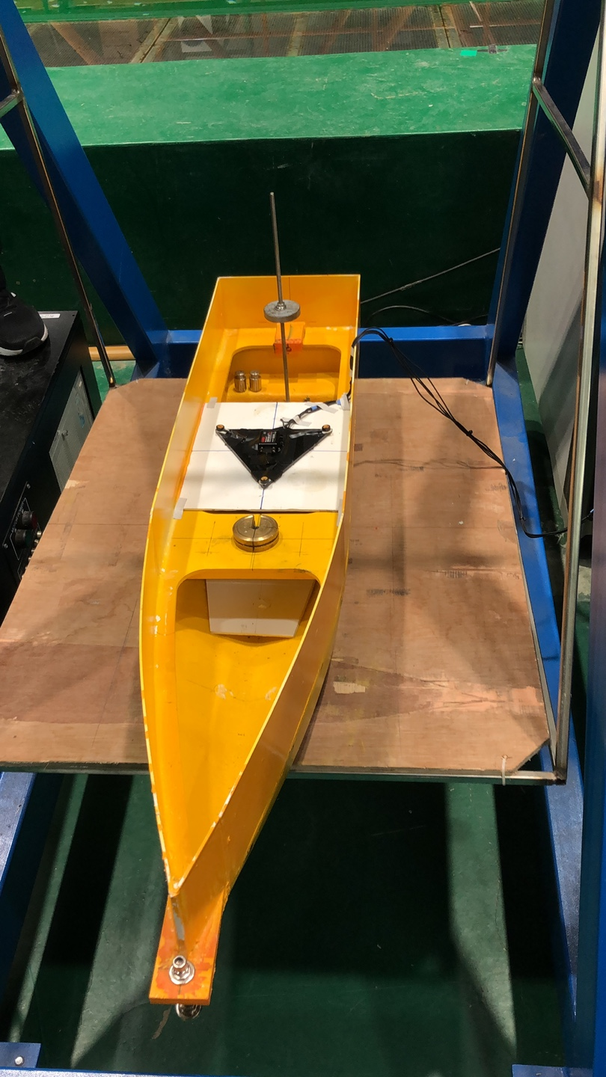
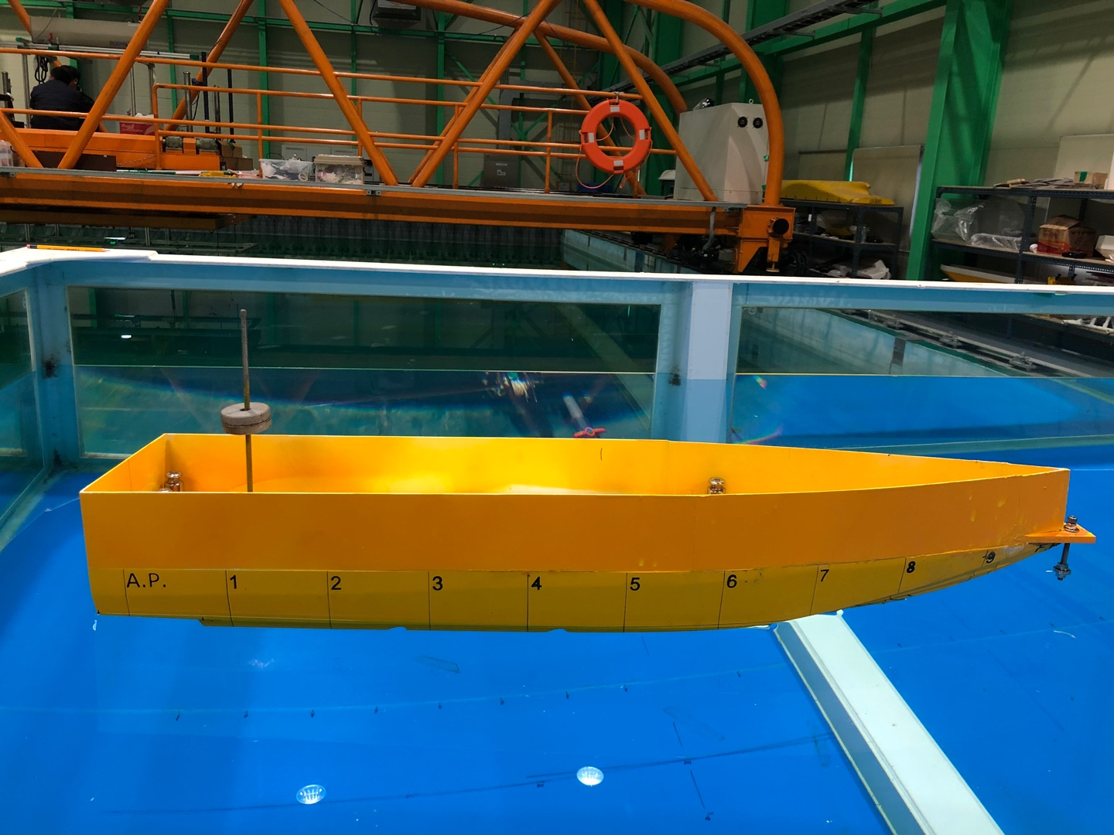
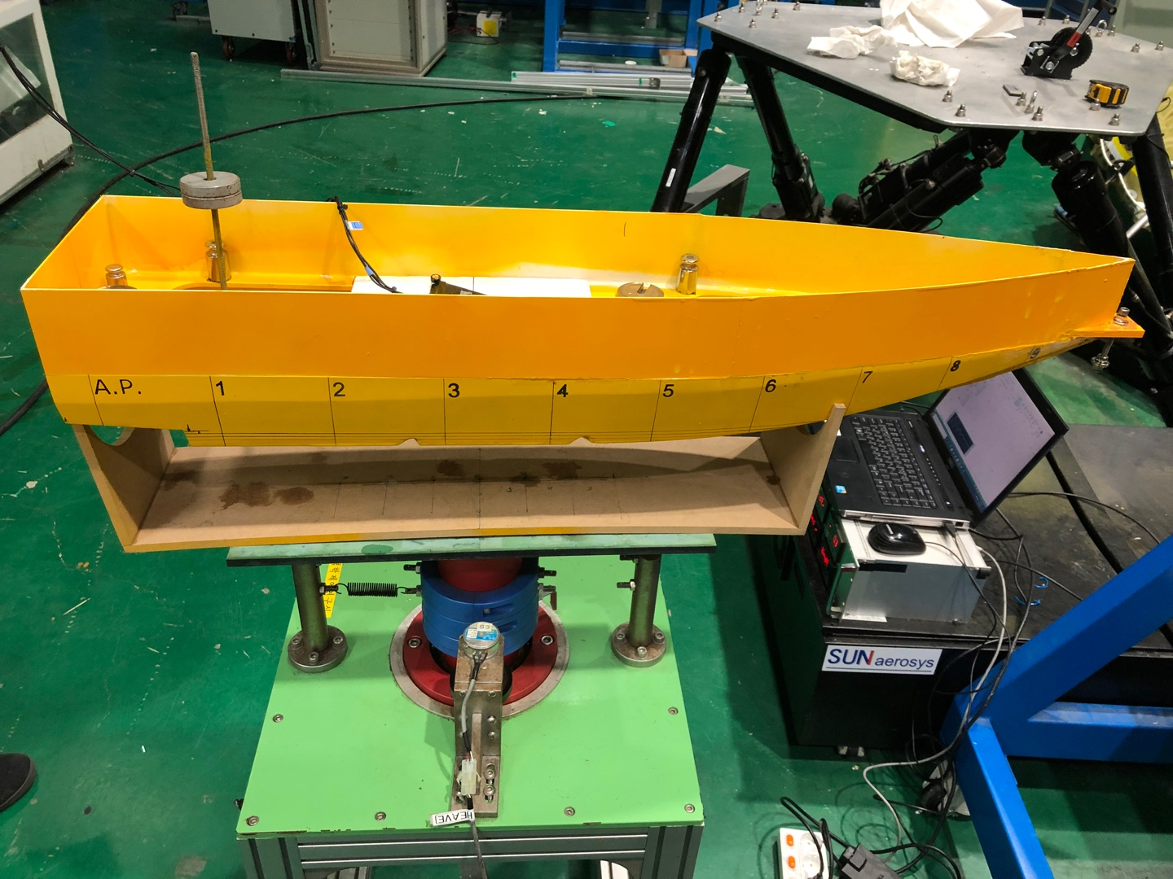
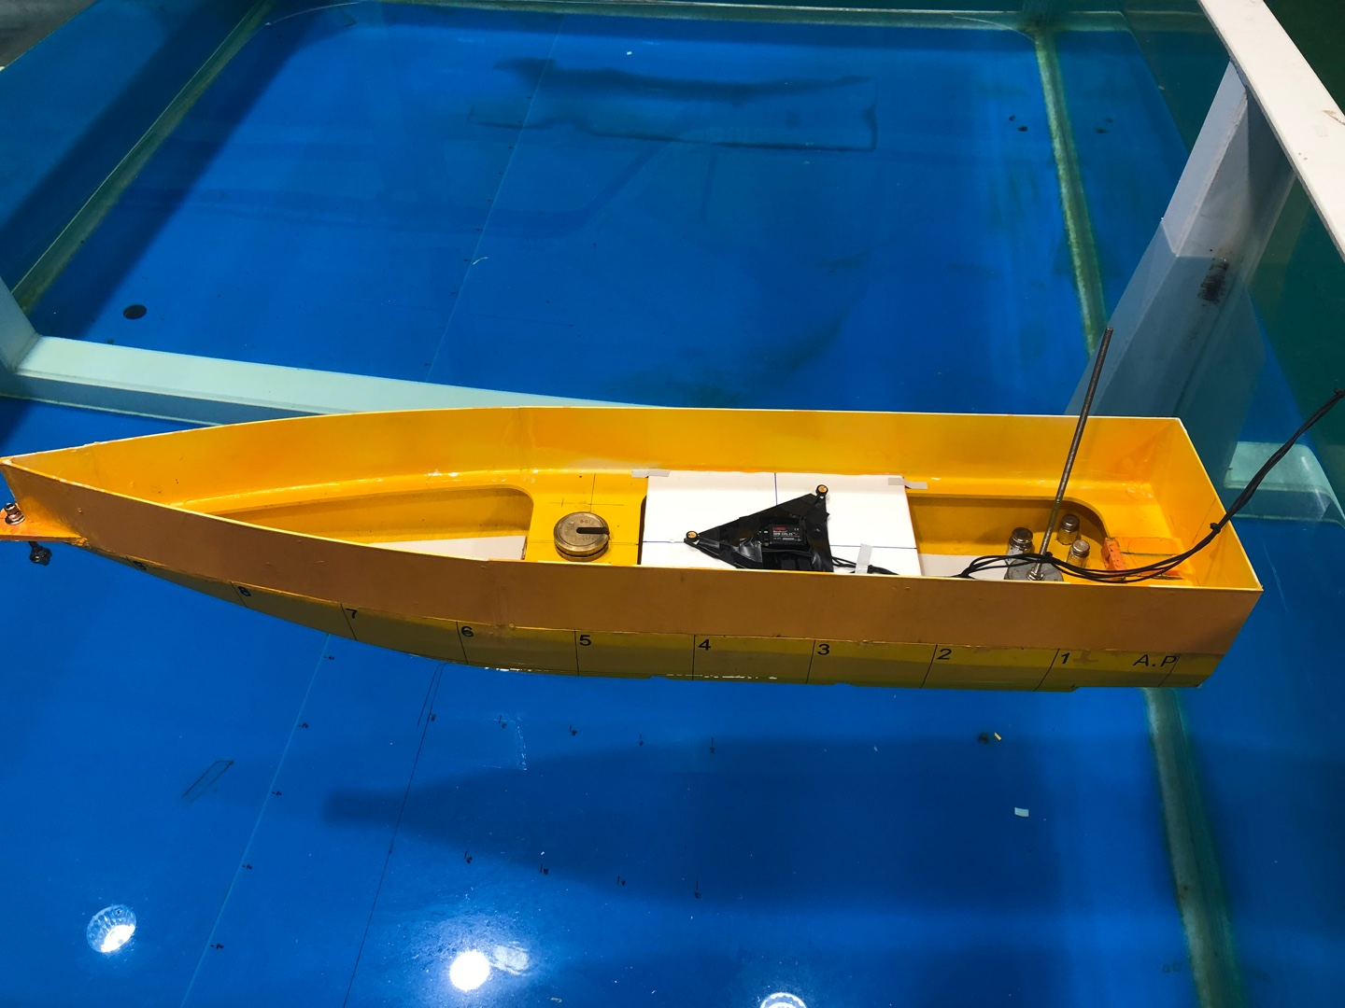
High speech ship
High speech ship
Main computer
Inertia test
Swing test
Ballasting test

Slide 5
High speech ship
High speech ship
Main computer
Inertia test
Swing test
Ballasting test

Slide 6
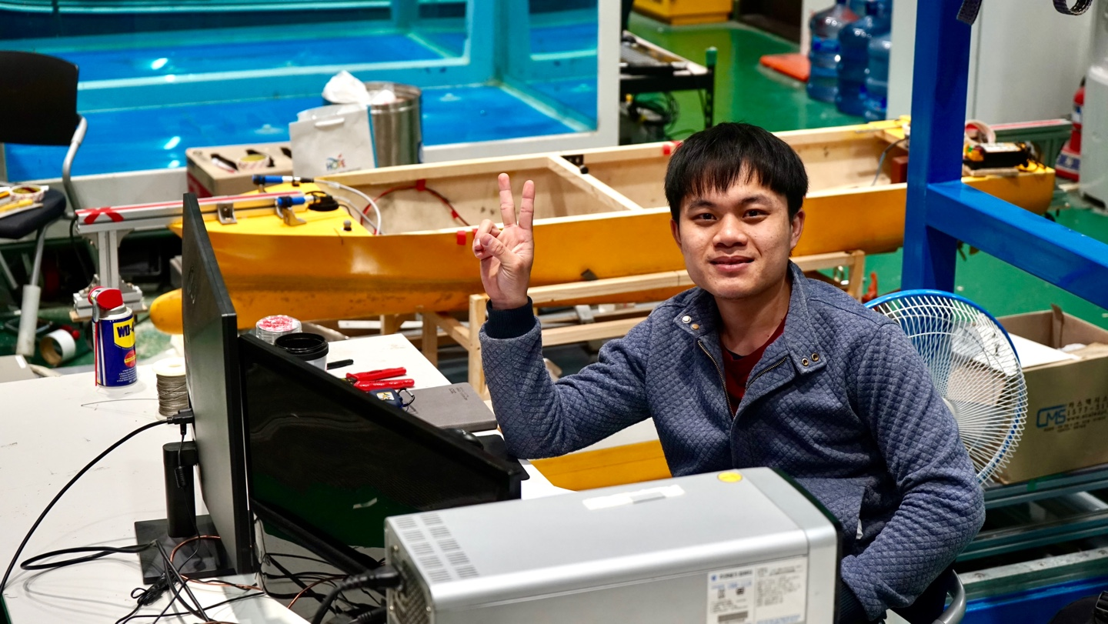
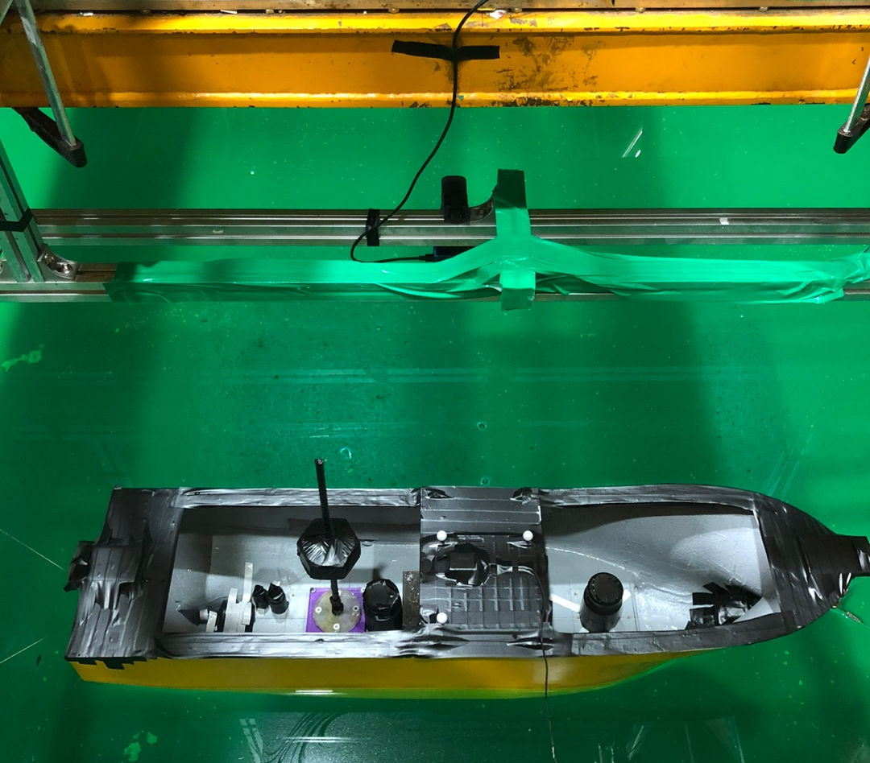
Trawler fishing
Trawler fishing
Model test

Slide 7
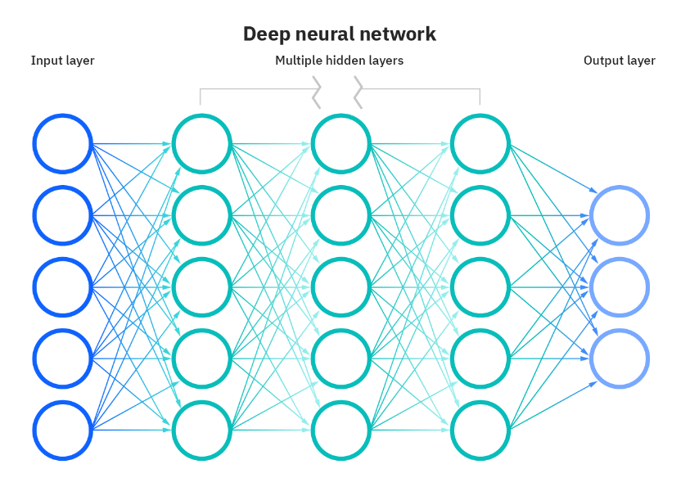
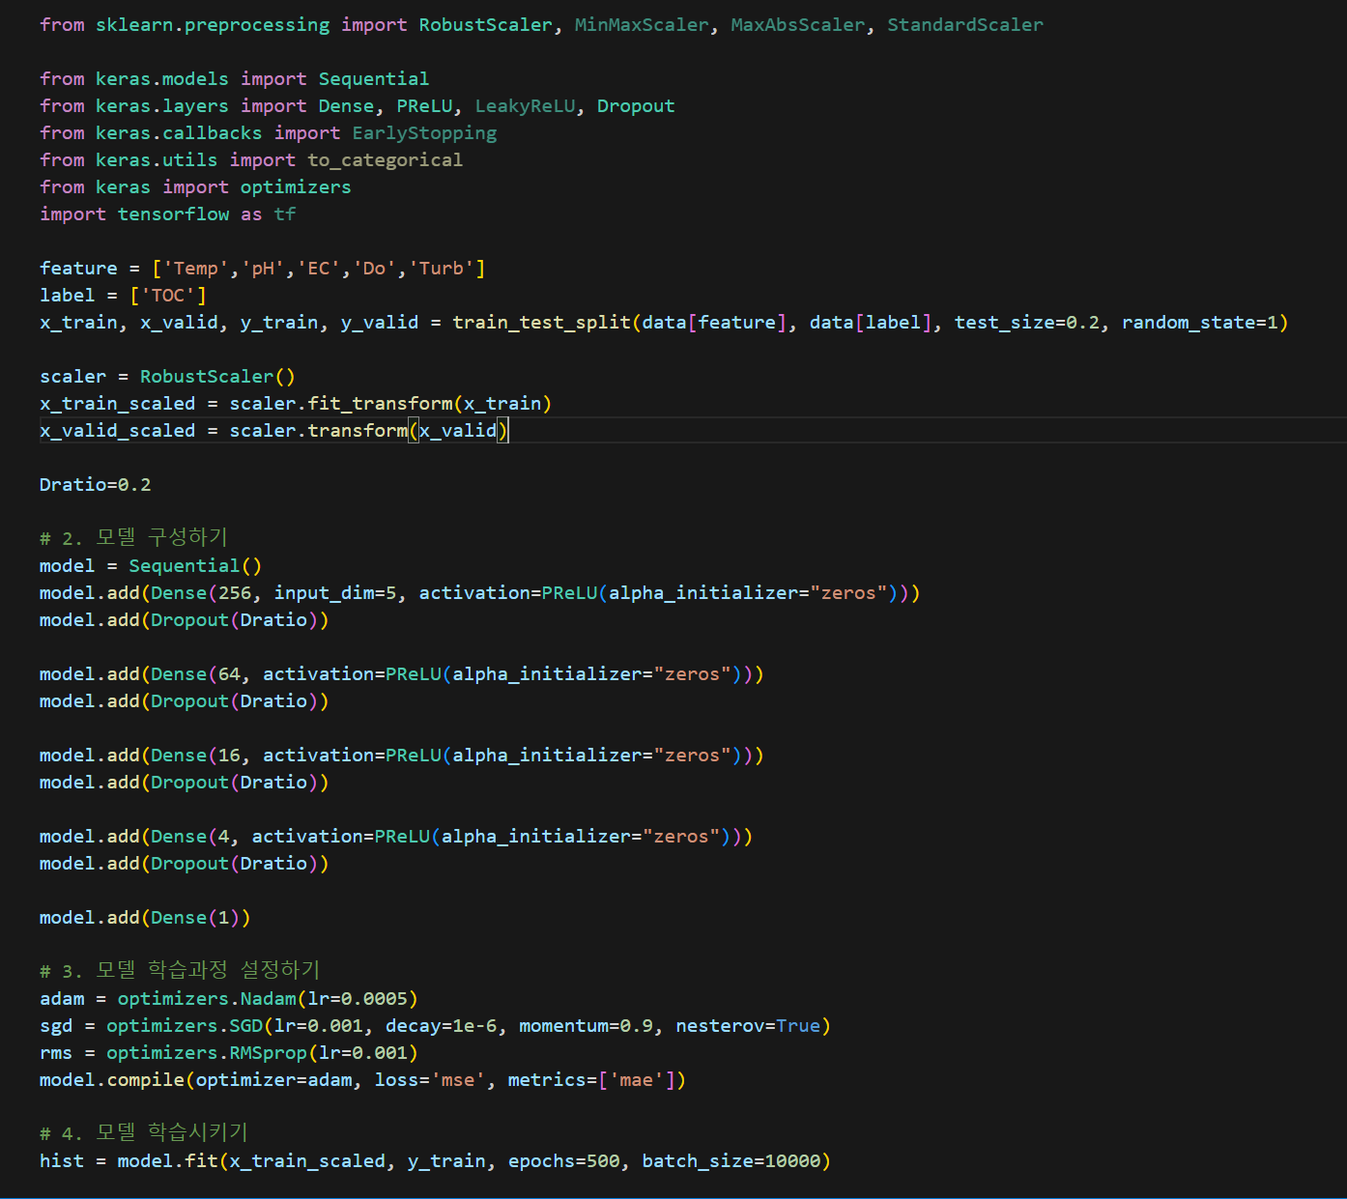
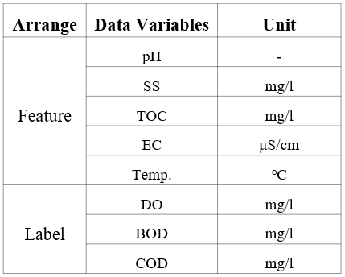
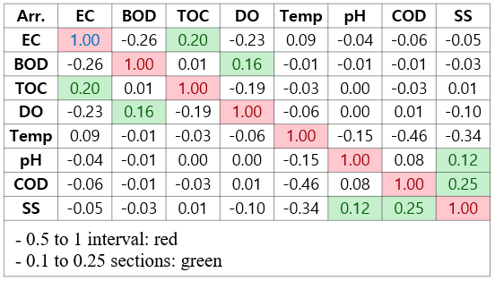
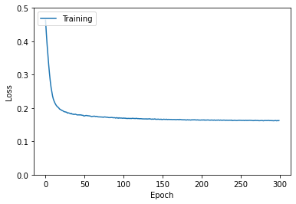
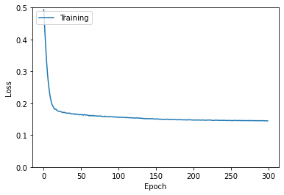
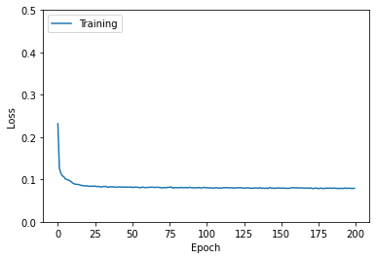
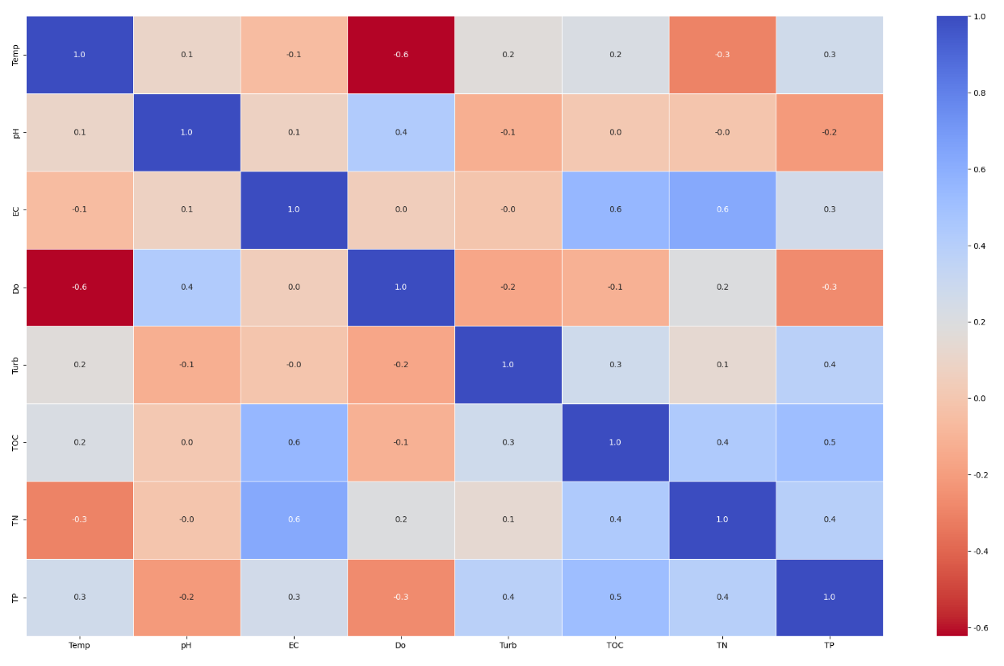
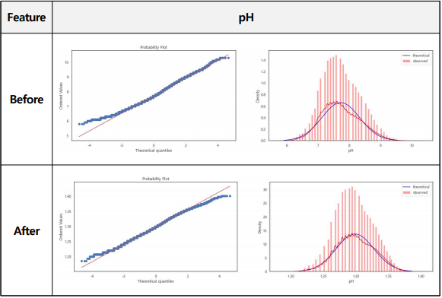
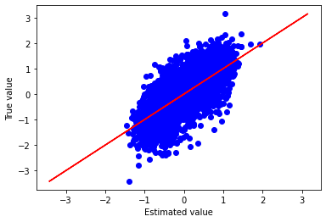
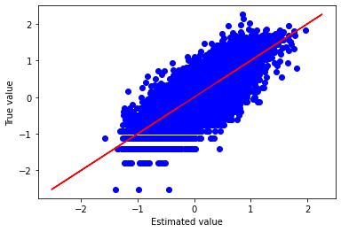
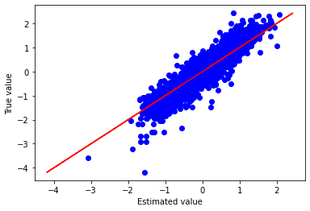
Machine Learning-Based Prediction Model for Soil Corrosion Rate Through Big Data Collection
Machine Learning model
Collecting Big data
Python: Keras library Activation func.: Irelu / prelu Optimization func.: Adam / sgd
Analyzing and Processing Missing Values
Learning curves results
- Missing values, correlations, Outlier, Standard/Normalizing, Box-Cox

Slide 8
Data Analysis and Processing Techniques: Correlation Coefficient Analysis Analyzing and Processing Missing Values Outlier Analysis and Processing Machine Learning model: Python-based Keras Library Activation Functions: ReLU/PReLU Optimization Functions: Adam/SGD Learning Curves: Training Loss vs. Validation Loss Training Accuracy vs. Validation Accuracy

Slide 9
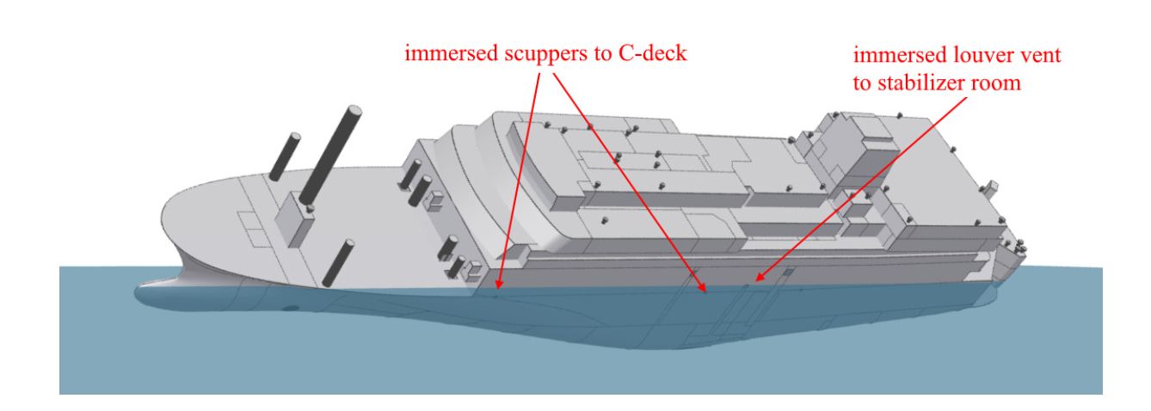
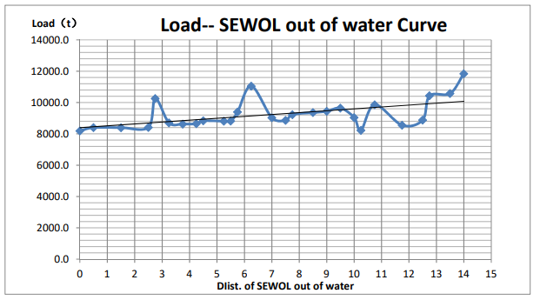
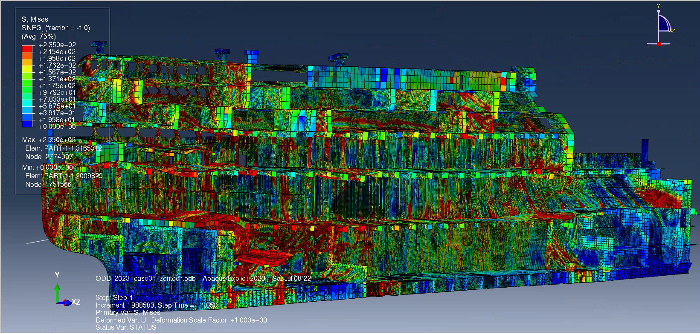
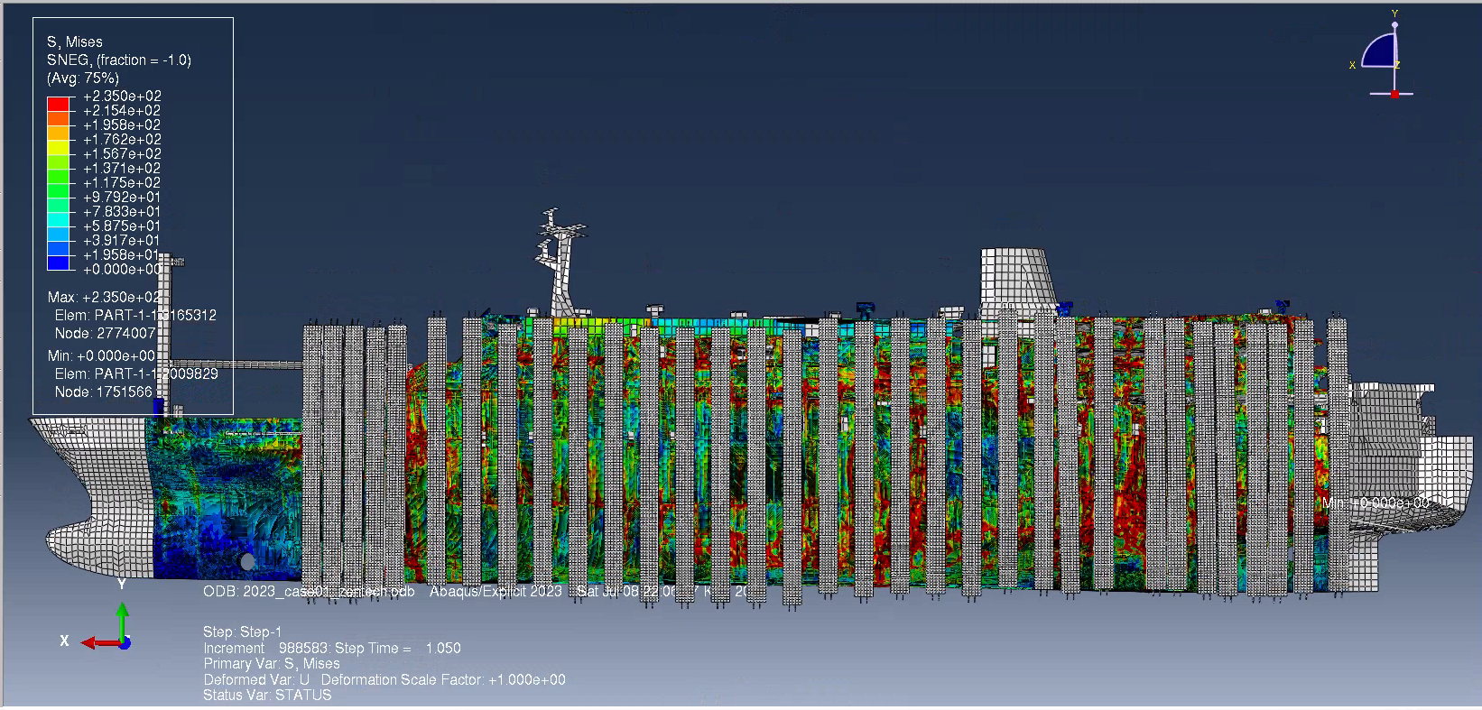
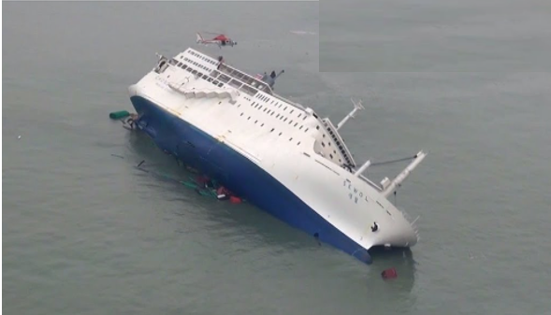
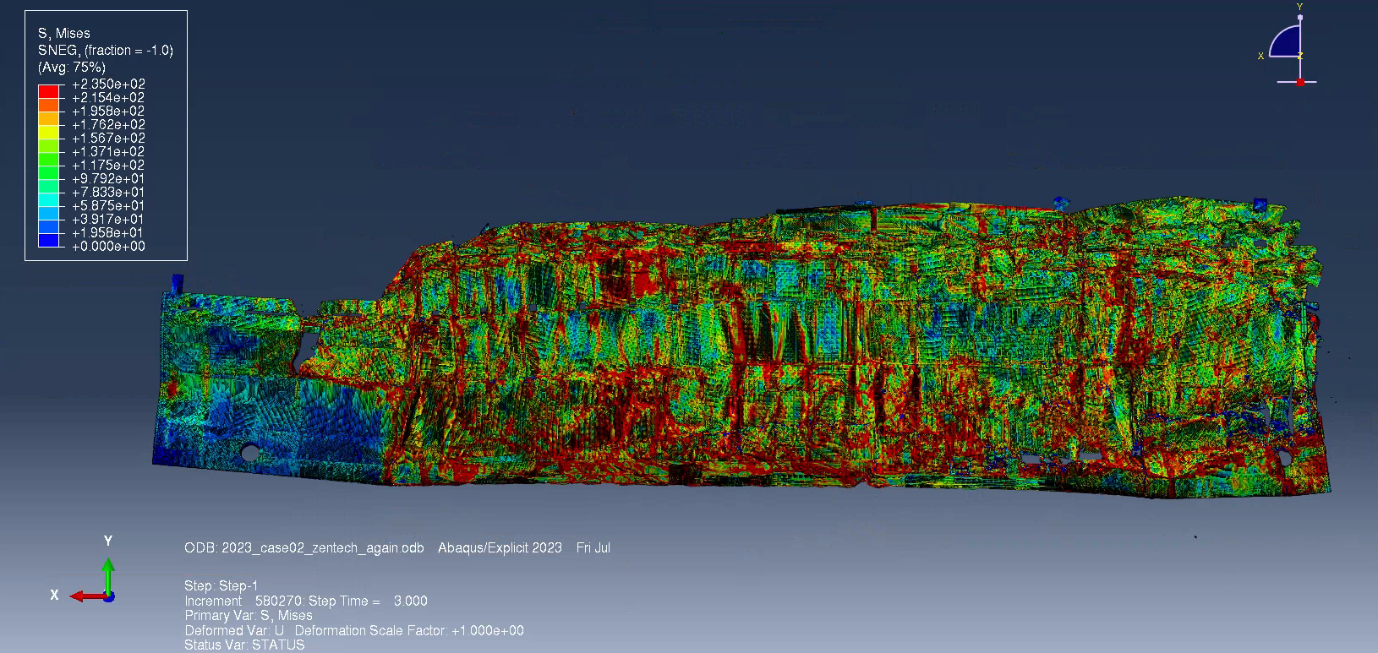
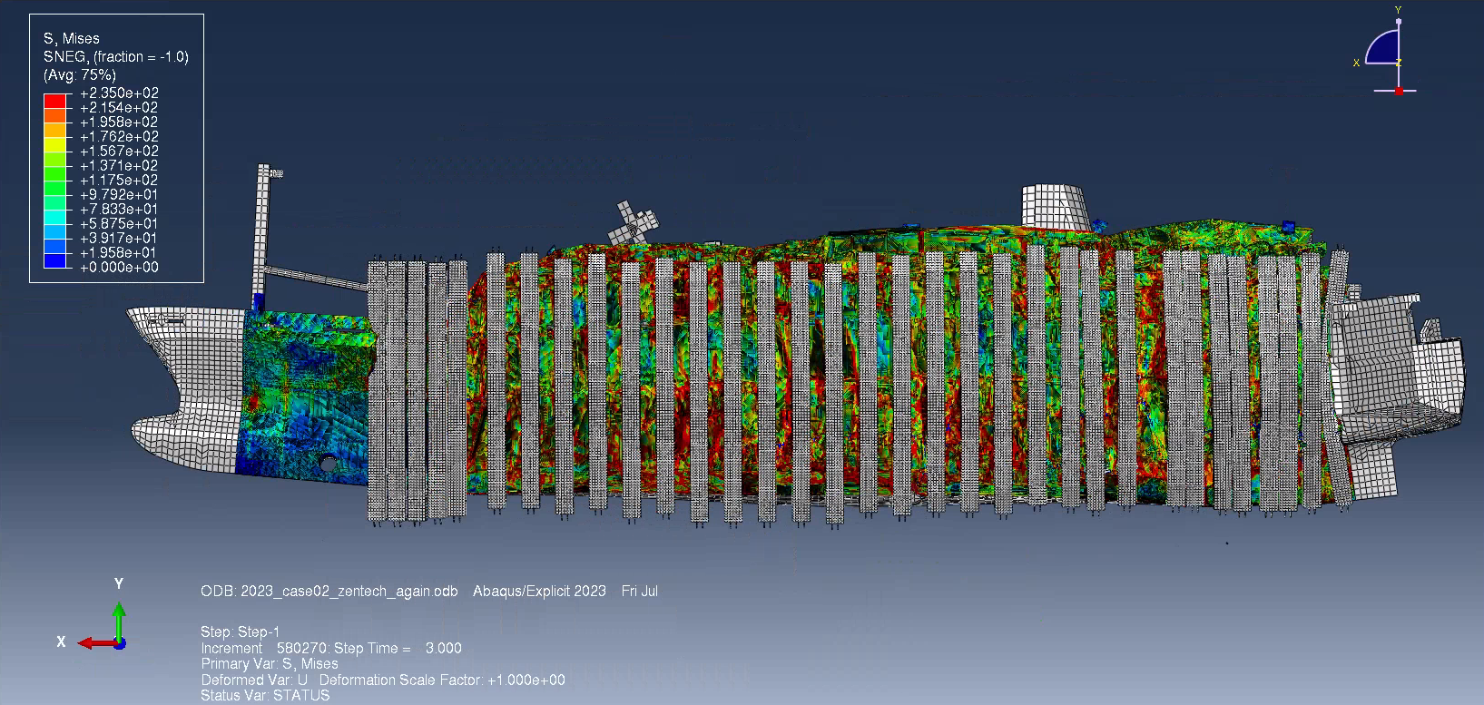
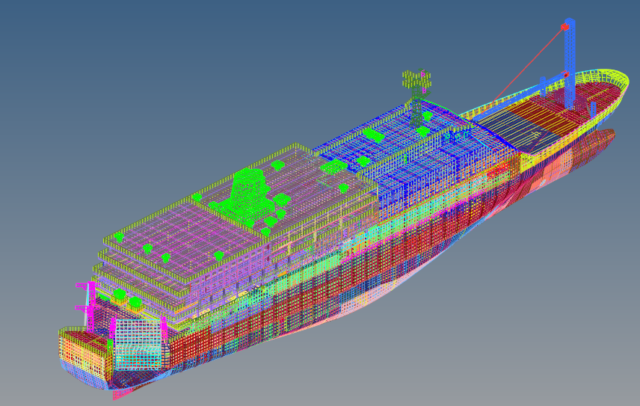
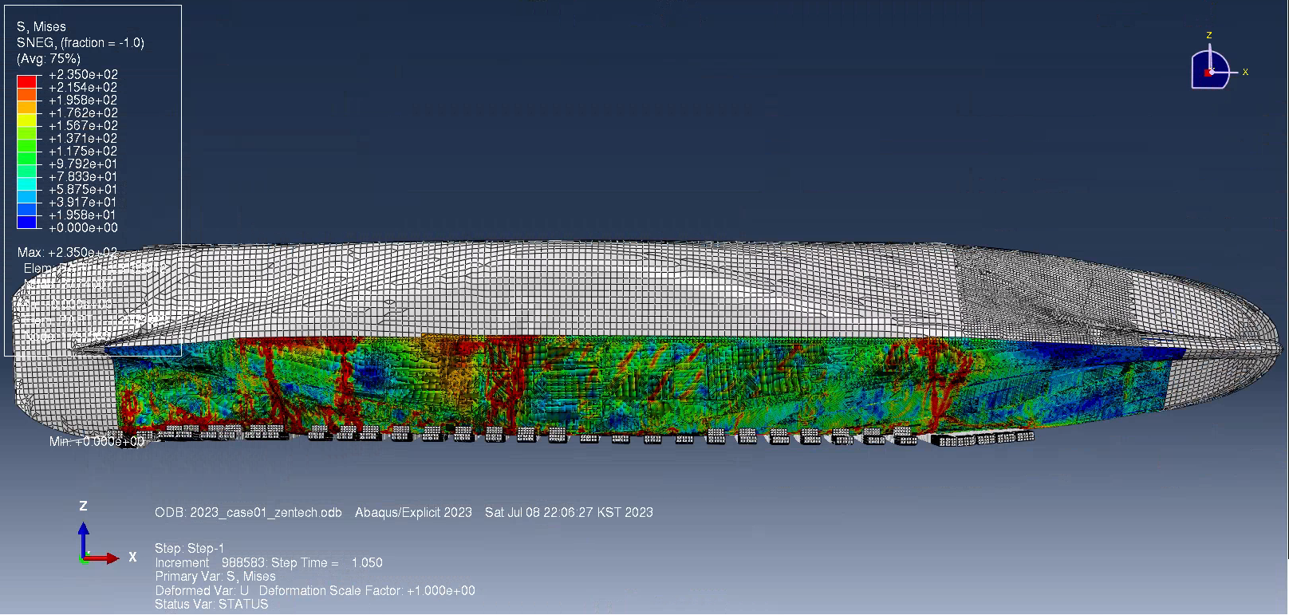
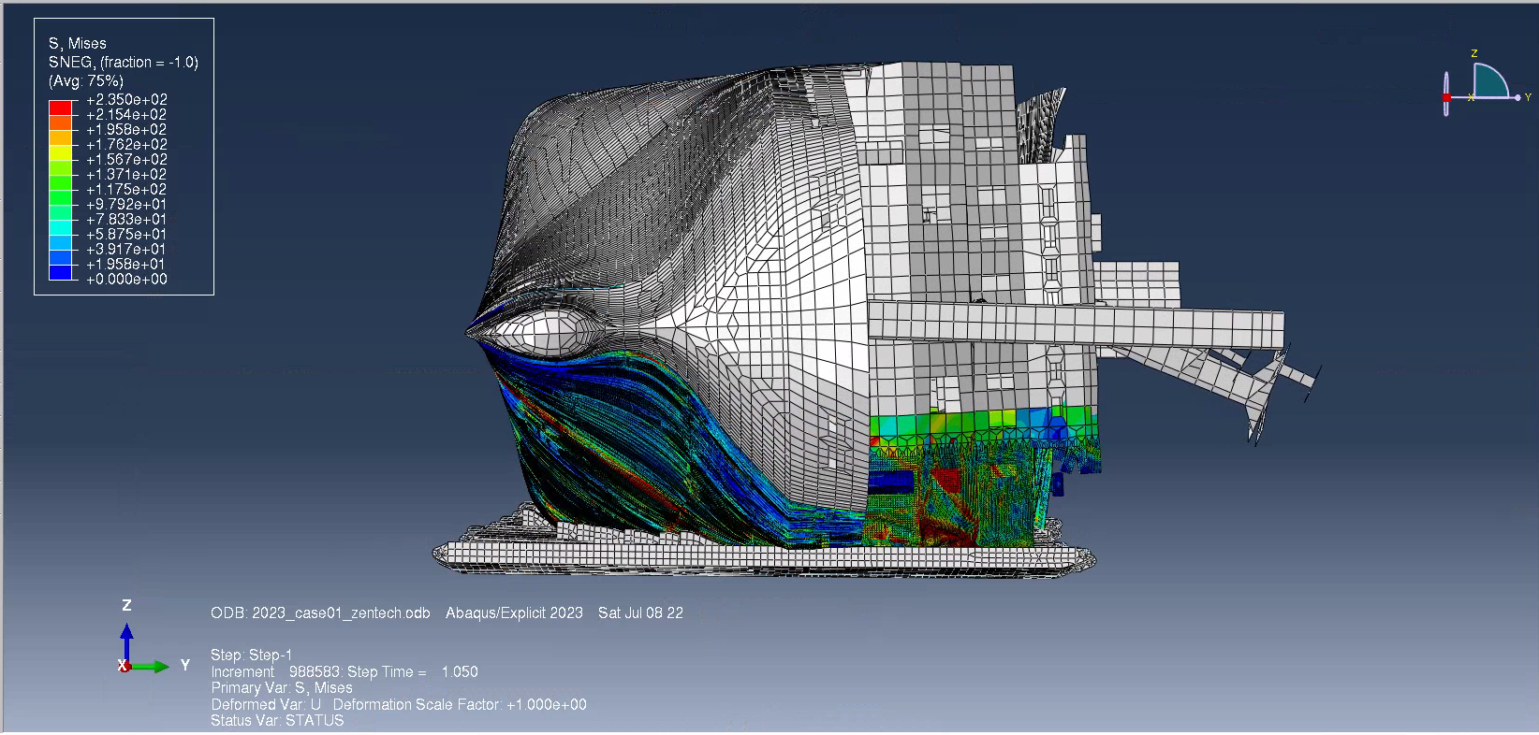
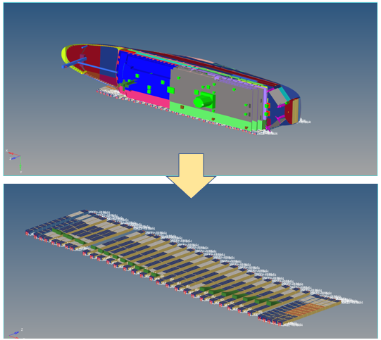
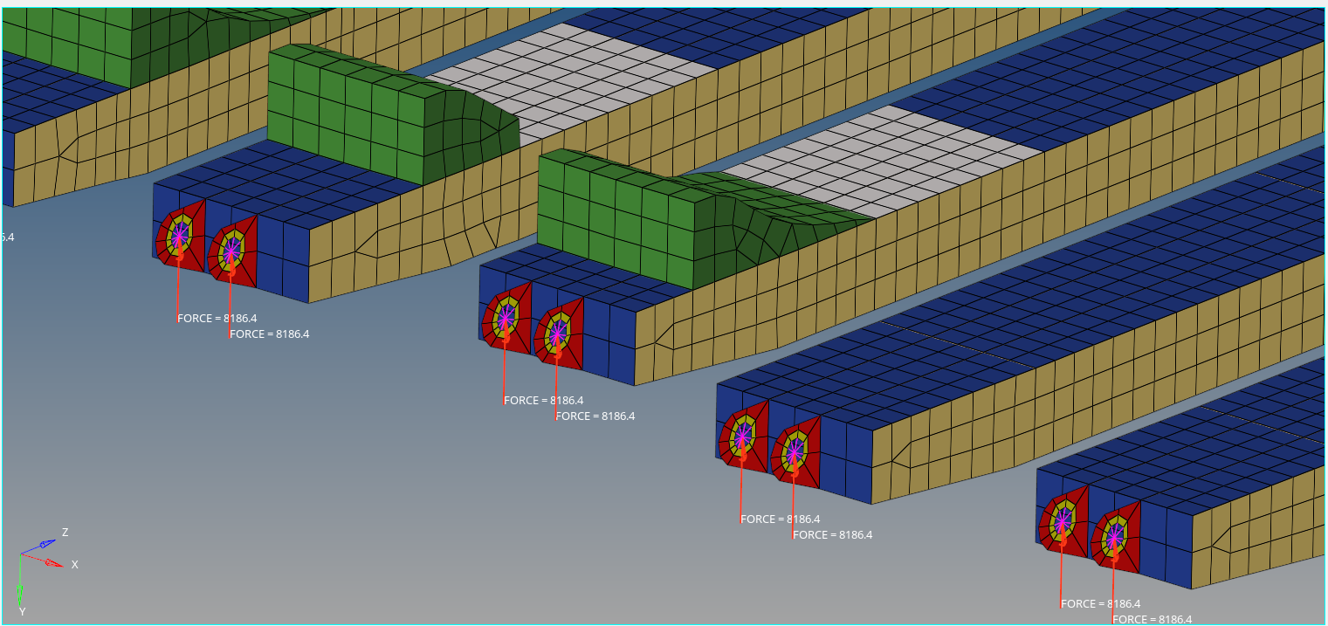
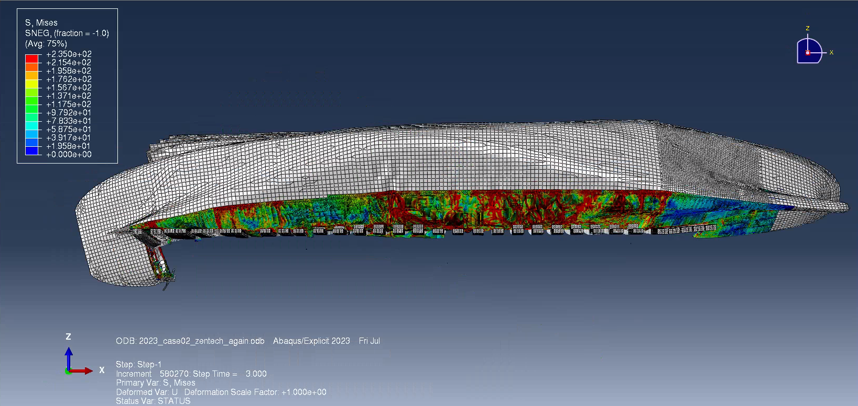
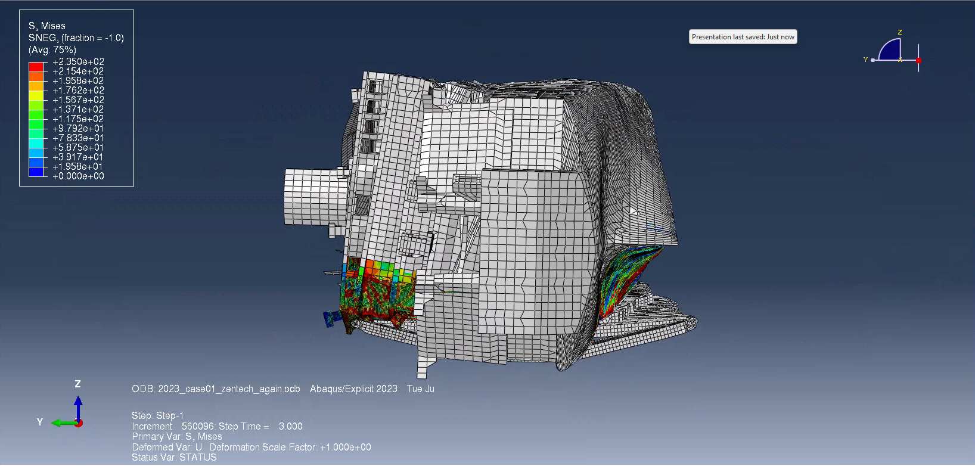
Lift Simulation for Ro-Ro Sewol Ferry Wreck Load out of Water Recovery Curve Analysis using ABAQUS
Initial position and actual measured
The results with different Loads - 16000ton, and 20000ton
Case: 01
< Actual measured value >
Case: 02
Arrangement of the model and lifting beam.
Case: 01
< Fine mesh the model by Hypermesh >
Case: 02

Slide 10
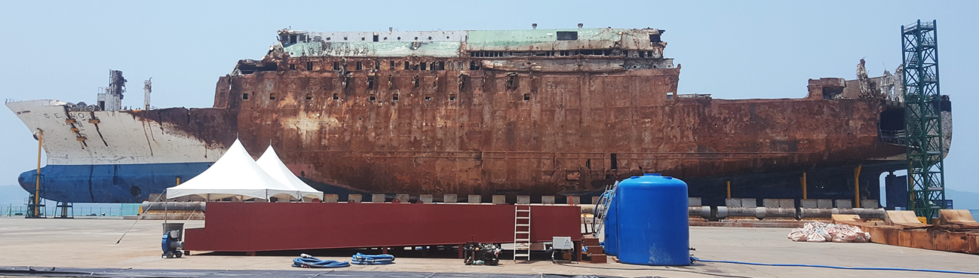
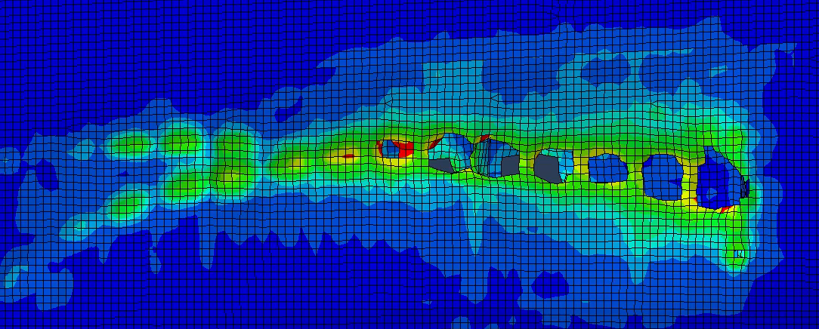
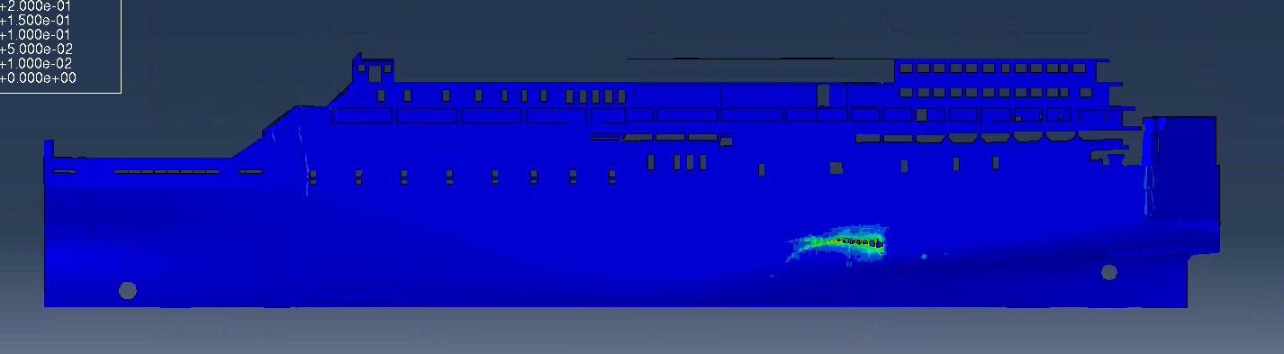
Optimizing mesh and simulating payload for the Sewol ferry with HyperMesh,
Execution using Abaqus and a comparative analysis of various loads

Slide 11
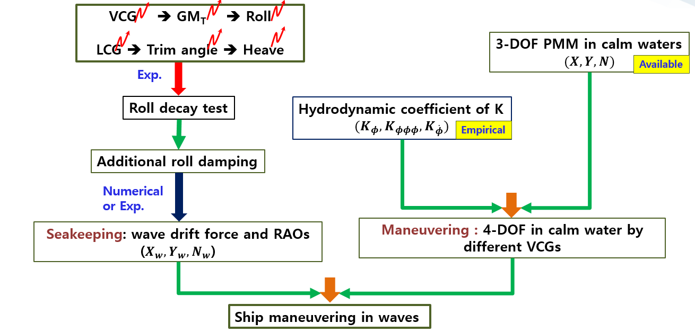
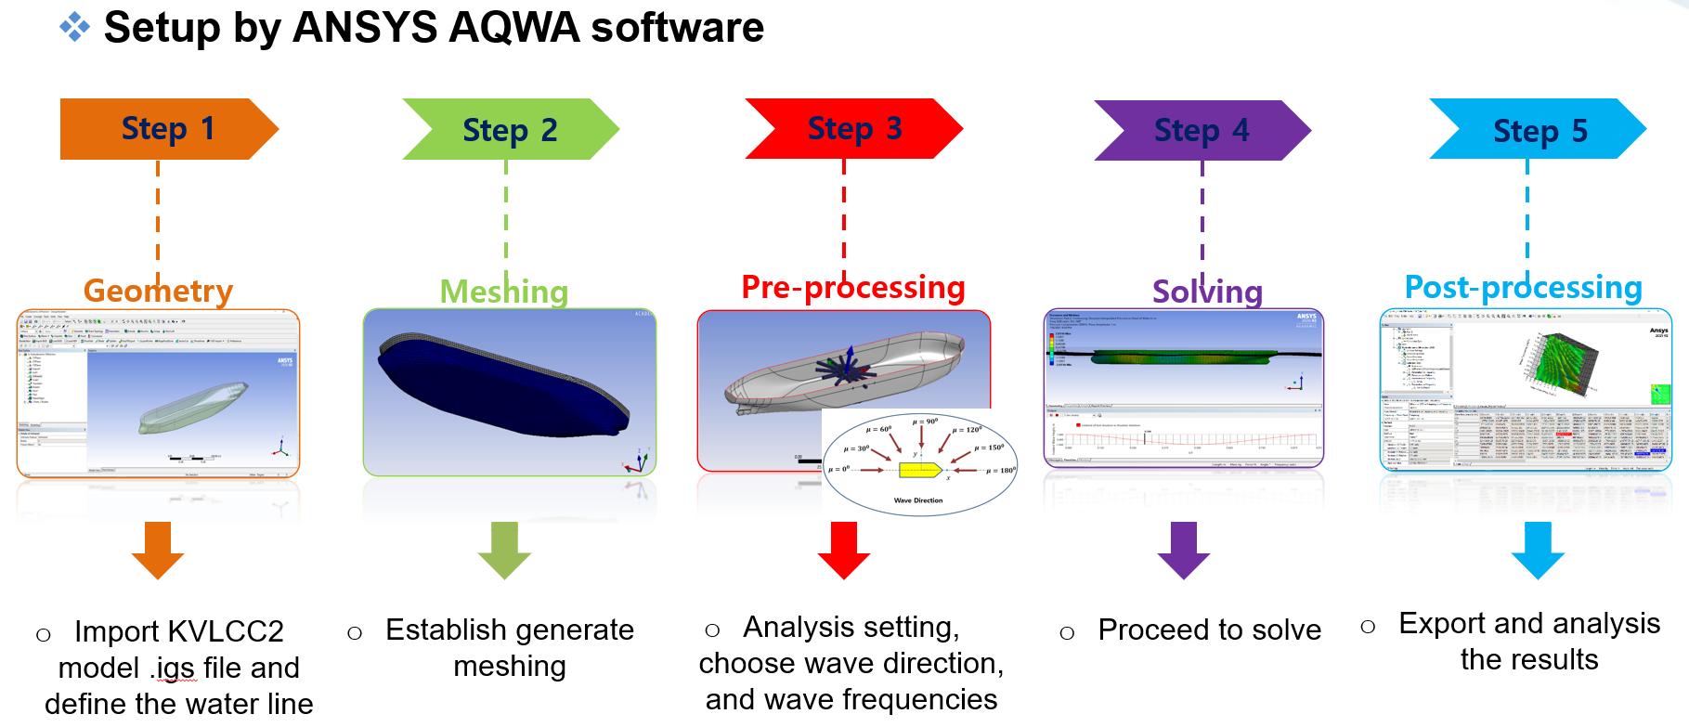
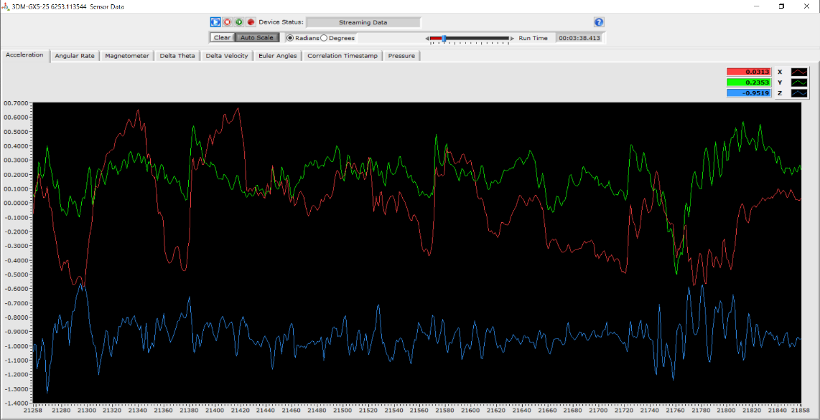


Numerical investigation of motion response of the tanker at varying VCGs
Research process graph
< Roll damping coefficient estimated Froud’s method >
IMU name
IMU
Data Recording
Commu. cable
Host computer
< Roll decay test results >
< RAO motion for various positions of GMs >

Slide 12
Perform Roll decay test with different GMs.
Estimation of Roll damping coefficient based on the time series by Froude’s method.
Motion response calculated using the 3D panel method.

Slide 13










AL
Initial models design
Meshing and simulation
Wave spectrum
< Hull acceleration of Roll results >
< Design of the model after checking the acceleration >
Sea state #1
Sea state #11

Slide 14
Modelling with 27 models with different bow.
Calculating wave spectrum with South Korea sea.
Mesh models with the max. of sea state values.
Simulation models with potential method in Ansys AQWA.
Estimation hull accelerations

Slide 15









Analysis of 560 kWh vortex buffer tank CFD
Design pipe inside of Tank
Internal pipe simulation results
Design cover outside of buffer Tank
Simulation results
Permissible temperature: 18.55℃
Analysis result: 18.23℃
< Temperature Distribution - Side View >

Slide 16
Verifying vortex type performance stable laminar flow formation.
Compare more efficient than conventional three-line branch pipes
Maximum calorific value that can be cooled by cold water inside the buffer tank
Power when all the heat stored in the buffer tank is discharged for a minimum period of times

Slide 17
%\\\textbullet{} Refinement of Components: Use HyperMesh software to refine the relevant parts using 100mm x 100mm shell elements.
%\\\textbullet{} Collision Simulation with Rocks: Perform collision a simulation between the KDDX-Class destroyer and reefs using Abaqus software.
%\\\textbullet{} Collision Simulation with Tankers and Container Ships: Conduct collision simulations between the KDDX-Class destroyer and tankers, as well as container ships, at different speeds using Abaqus software.
%\\\textbullet{} Impact Damage Calculation: Calculate the extent of destruction and impact damage for each collision simulation.},
%-------------------------jOB--------------------------- %\\\textbullet{} Mesh optimization and payload simulation for Sewol ferry using HyperMesh and Abaqus, with comparative analysis of experimental results, Inha University, South Korea"},
%\\\textbullet{}Conducted pre-tests, including calibration, ballast, inertia test, and roll decay test, to ensure model accuracy and reliability.
%\\\textbullet{}Set up the model in a test tank attached to the carriage above the tank.
%\\\textbullet{}Performed seakeeping tests to measure the movement of the Garbage Barge ship.
%\\\textbullet{}Analyzed data and evaluated the model and experiment for further insights and improvements.},

Slide 18











Collision Simulation with Rocks [30, 60, 90 deg.]
Collision simulation for various positions
Rock 30deg.
Rock 60deg.
Results of collision at middle ship
Rock 90deg.
Displacement
- Minim. operation: 8340.35ton
- Full port: 9226.75ton

Slide 19
Simulation KDDX for different directions and positions ( Forward, Middle and Stern) by Abaqus.
Calculating crack of collision using Matlab code.
Refinement of Components: 100mm x 100mm shell elements
Collision Simulation with Rocks (30, 60, 90 degrees)
Collision Simulation with Tankers and Container Ships
Calculating the extent of destruction and impact damage for each collisions.

Slide 20












Seismic analysis models after simulation by Abaqus
Models at facilities
Model-01
Model-02
Model-03
< Model design >
Model-04
Model-05

Slide 21
Analysis of Seismic simulation based apply external load for fires.

